Slide 1
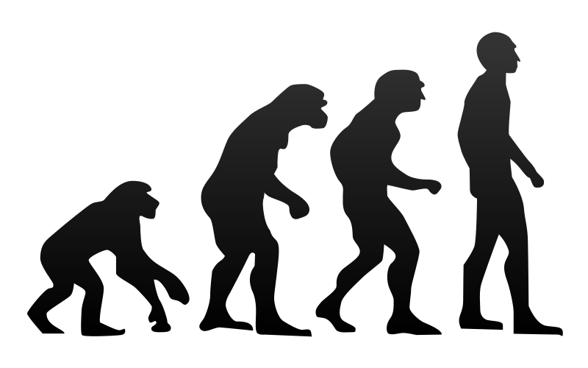
Evolution of the Entity Framework
K. Scott Allen
@OdeToCode

Slide 2
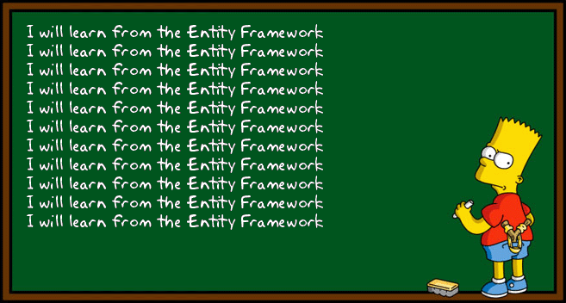

Slide 3
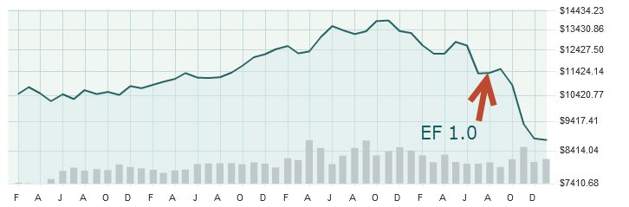

Slide 4

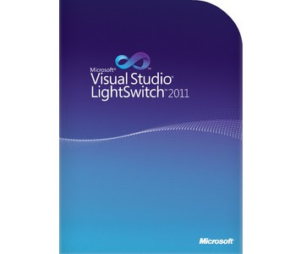
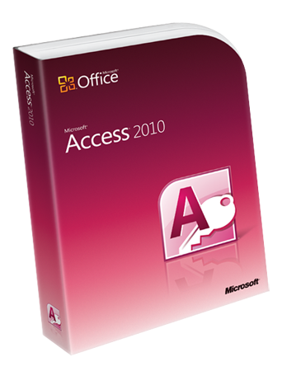

Slide 5
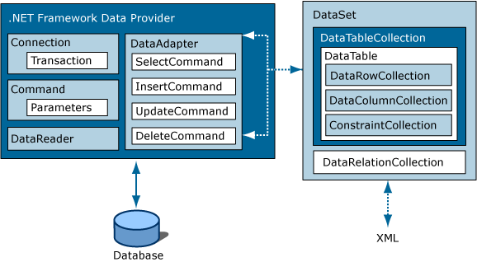

Slide 6
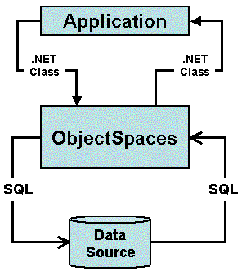

Slide 7


Slide 8
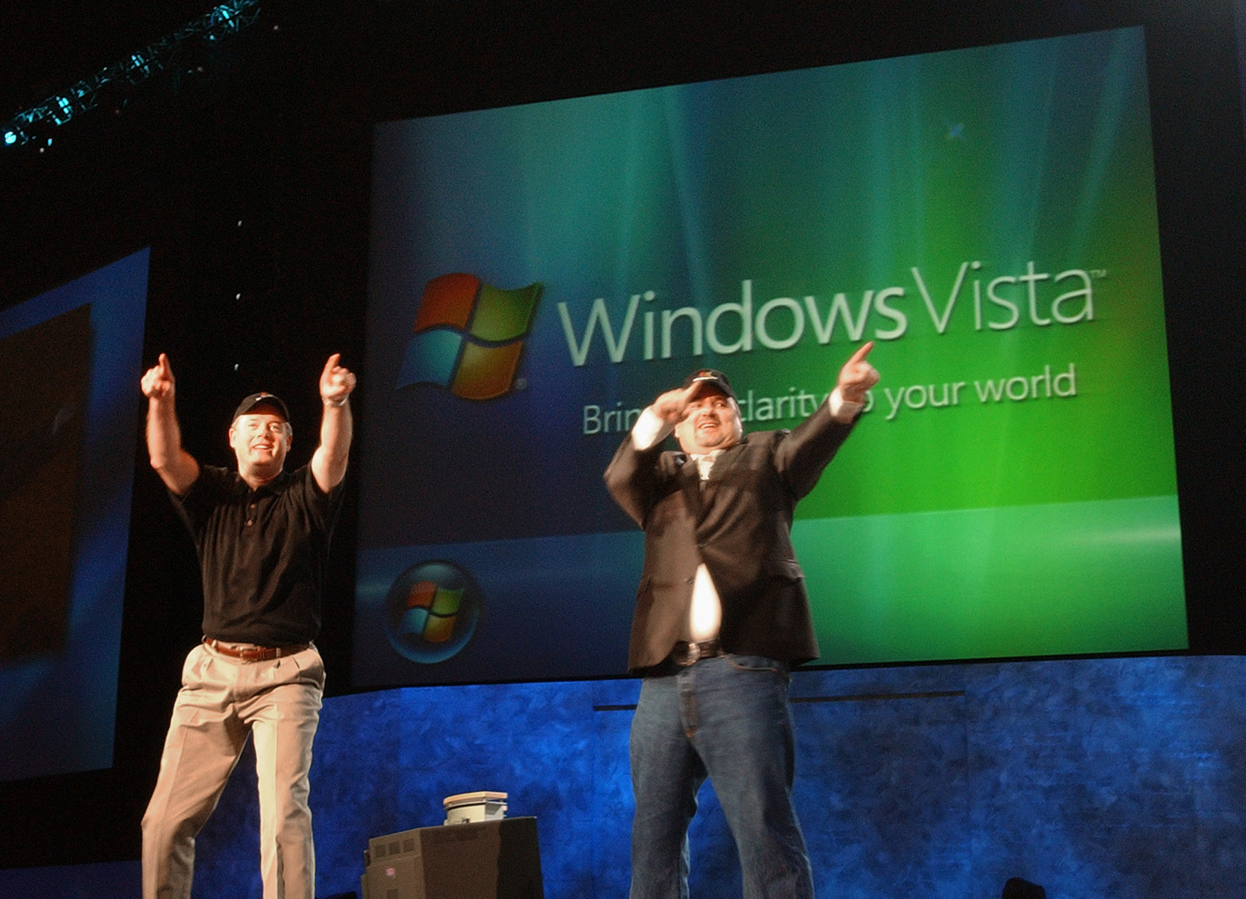

Slide 9
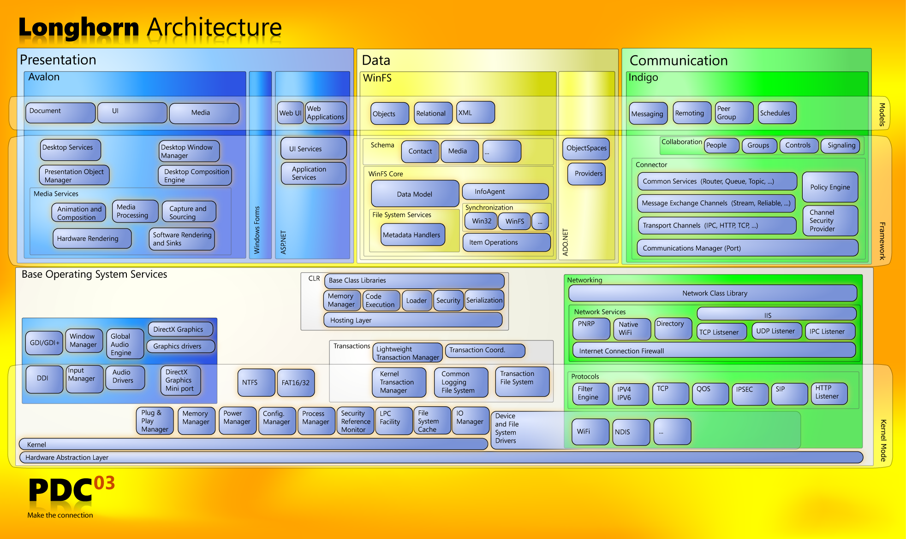


Slide 10
Why WinFS?
In the technology industry, there is a growing "perfect storm"—a combination of trends and technologies that will allow the next quantum leap in the way you develop and work with your information.
http://msdn.microsoft.com/en-us/library/aa480687.aspx

Slide 11
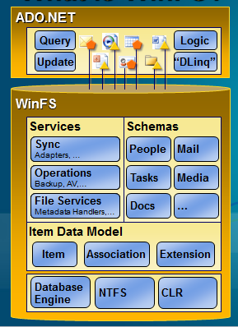

Slide 12
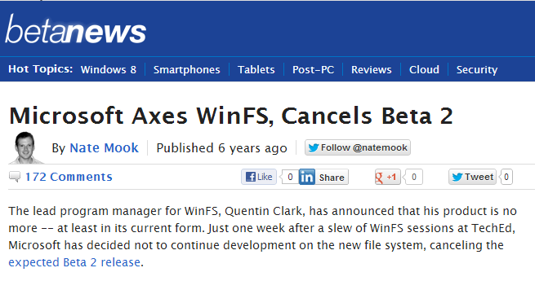

Slide 13
“The Origin of LINQ to SQL”
We on the outside used to refer to WinFS as the black hole, forever growing, sucking up all available resources, letting nothing escape and in the end producing nothing except possibly a gateway to an alternate reality.
http://blogs.msdn.com/b/mattwar/archive/2007/05/31/the-origin-of-linq-to-sql.aspx

Slide 14


Slide 15
“Architecture astronauts take over”
The hallmark of an architecture astronaut is that they don't solve an actual problem... they solve something that appears to be the template of a lot of problems. Or at least, they try.
http://www.joelonsoftware.com/items/2008/05/01.html

Slide 16
Lesson 1 Don’t Let The Astronauts Solve The Customer’s Problem

Slide 17
Where is WinFS now?
The WinFS APIs were a precursor to a more generalized set of object/relational APIs, which is now shipping as what we call entity framework in ADO.NET.
http://channel9.msdn.com/Blogs/JonUdell/Where-is-WinFS-now

Slide 18
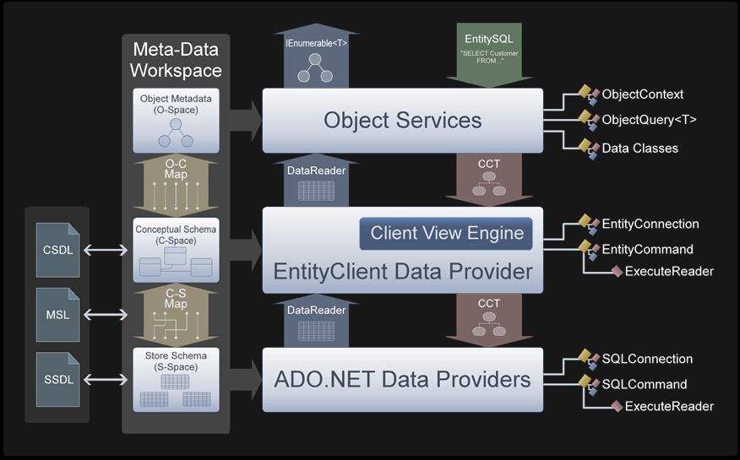

Slide 21
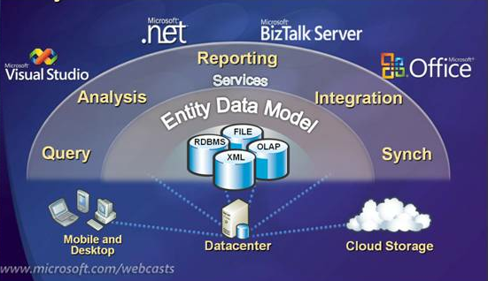

Slide 23
Unimplemented LINQ operators
No capability for model-first design
No support for complex types
No support for enum types or unsigned integers
No implicit loading of relationships
Limited stored procedure support
Unnecessarily complexity in generated SQL code
Unnecessary complexity in generated C# code
Performance

Slide 24
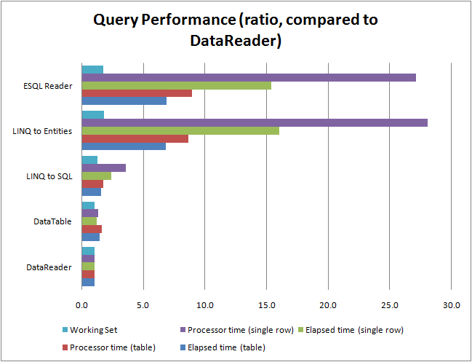
http://toomanylayers.blogspot.com/2009/01/entity-framework-and-linq-to-sql.html

Slide 25

Why is Dropbox more popular than other programs with similar functionality?

Slide 26
Well, let's take a step back and think about the sync problem and what the ideal solution for it would do:
There would be a folder.
You'd put your stuff in it.
It would sync.
They built that.
http://www.quora.com/Dropbox/Why-is-Dropbox-more-popular-than-other-programs-with-similar-functionality

Slide 27
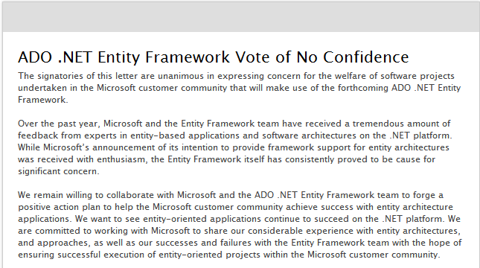

Slide 28
Lesson 2 Solve One Customer Problem Well

Slide 29
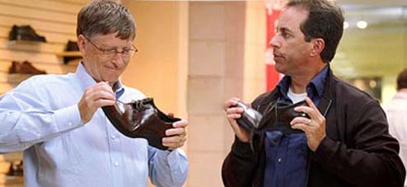

Slide 30
EF is not an ORM
Often, people categorize Entity Framework as an Object/Relational Mapper and try to compare it to other O/R Mappers. I dare say that’s an apples-to-oranges kind of comparison.
…
Entity Framework is much bigger than a mere O/R Mapper. It is a conceptual-level development platform, and its ORM capabilities are an interface for applications to interact with conceptual models.
http://blogs.msdn.com/b/esql/archive/2007/12/14/entityframework_5f00_orm.aspx

Slide 31
Why Use EF?
The big difference between the EF and nHibernate is around the Entity Data Model (EDM) and the long-term vision for the data platform we are building around it.
http://blogs.msdn.com/b/dsimmons/archive/2008/05/17/why-use-the-entity-framework.aspx

Slide 32


Slide 33



Slide 34


Slide 35


Slide 36

LINQ to SQL
Silverlight
SQL Notification Services
Data Transformation Services
Oslo / M
CardSpace
Hailstorm
Windows CE
Code Access Security
Office Web Components

Slide 37
Lesson 3 Don’t Ask The Customer For A Long Term Loan

Slide 38
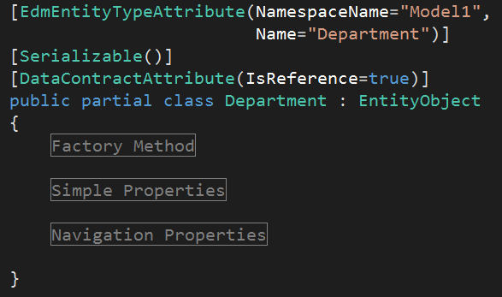

Slide 39
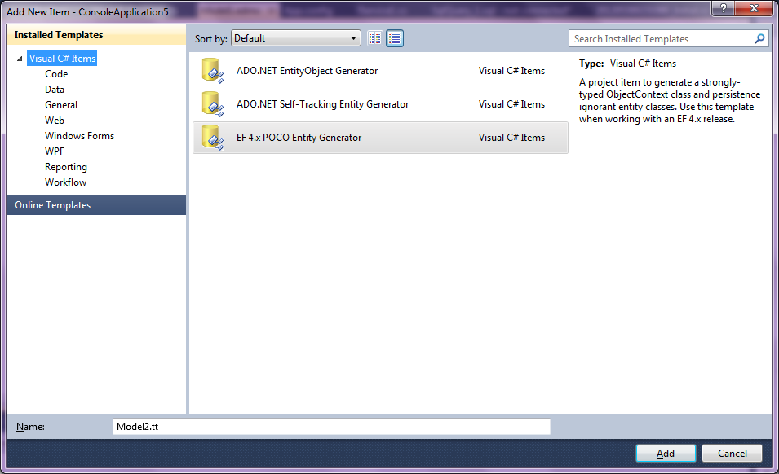

Slide 40

There is less cognitive load because rather than being forced to think about everything—business logic, persistence, transactions etc.—at once you can instead focus on one thing at a time.
You can first design and implement the business logic and then, once that is working, you can deal with persistence and transactions.

Slide 41
The Entity Framework encourages the Anemic Domain Model anti-pattern by discouraging the inclusion of business logic in the entity classes. While it is possible for the business logic to be written in partial classes, this adds some awkwardness to the code as the entity data and the entity business rules and logic live in separate knowledge and user experience contexts.

Slide 42


Slide 43


Slide 44
Lesson 4 Understand the Customer’s Problem

Slide 45
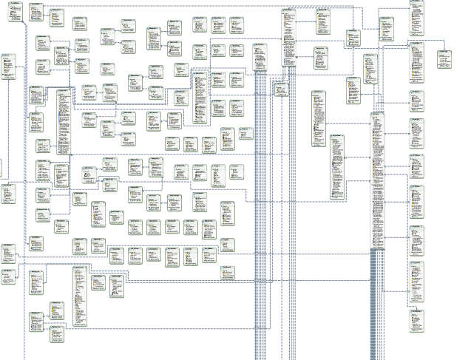

Slide 46
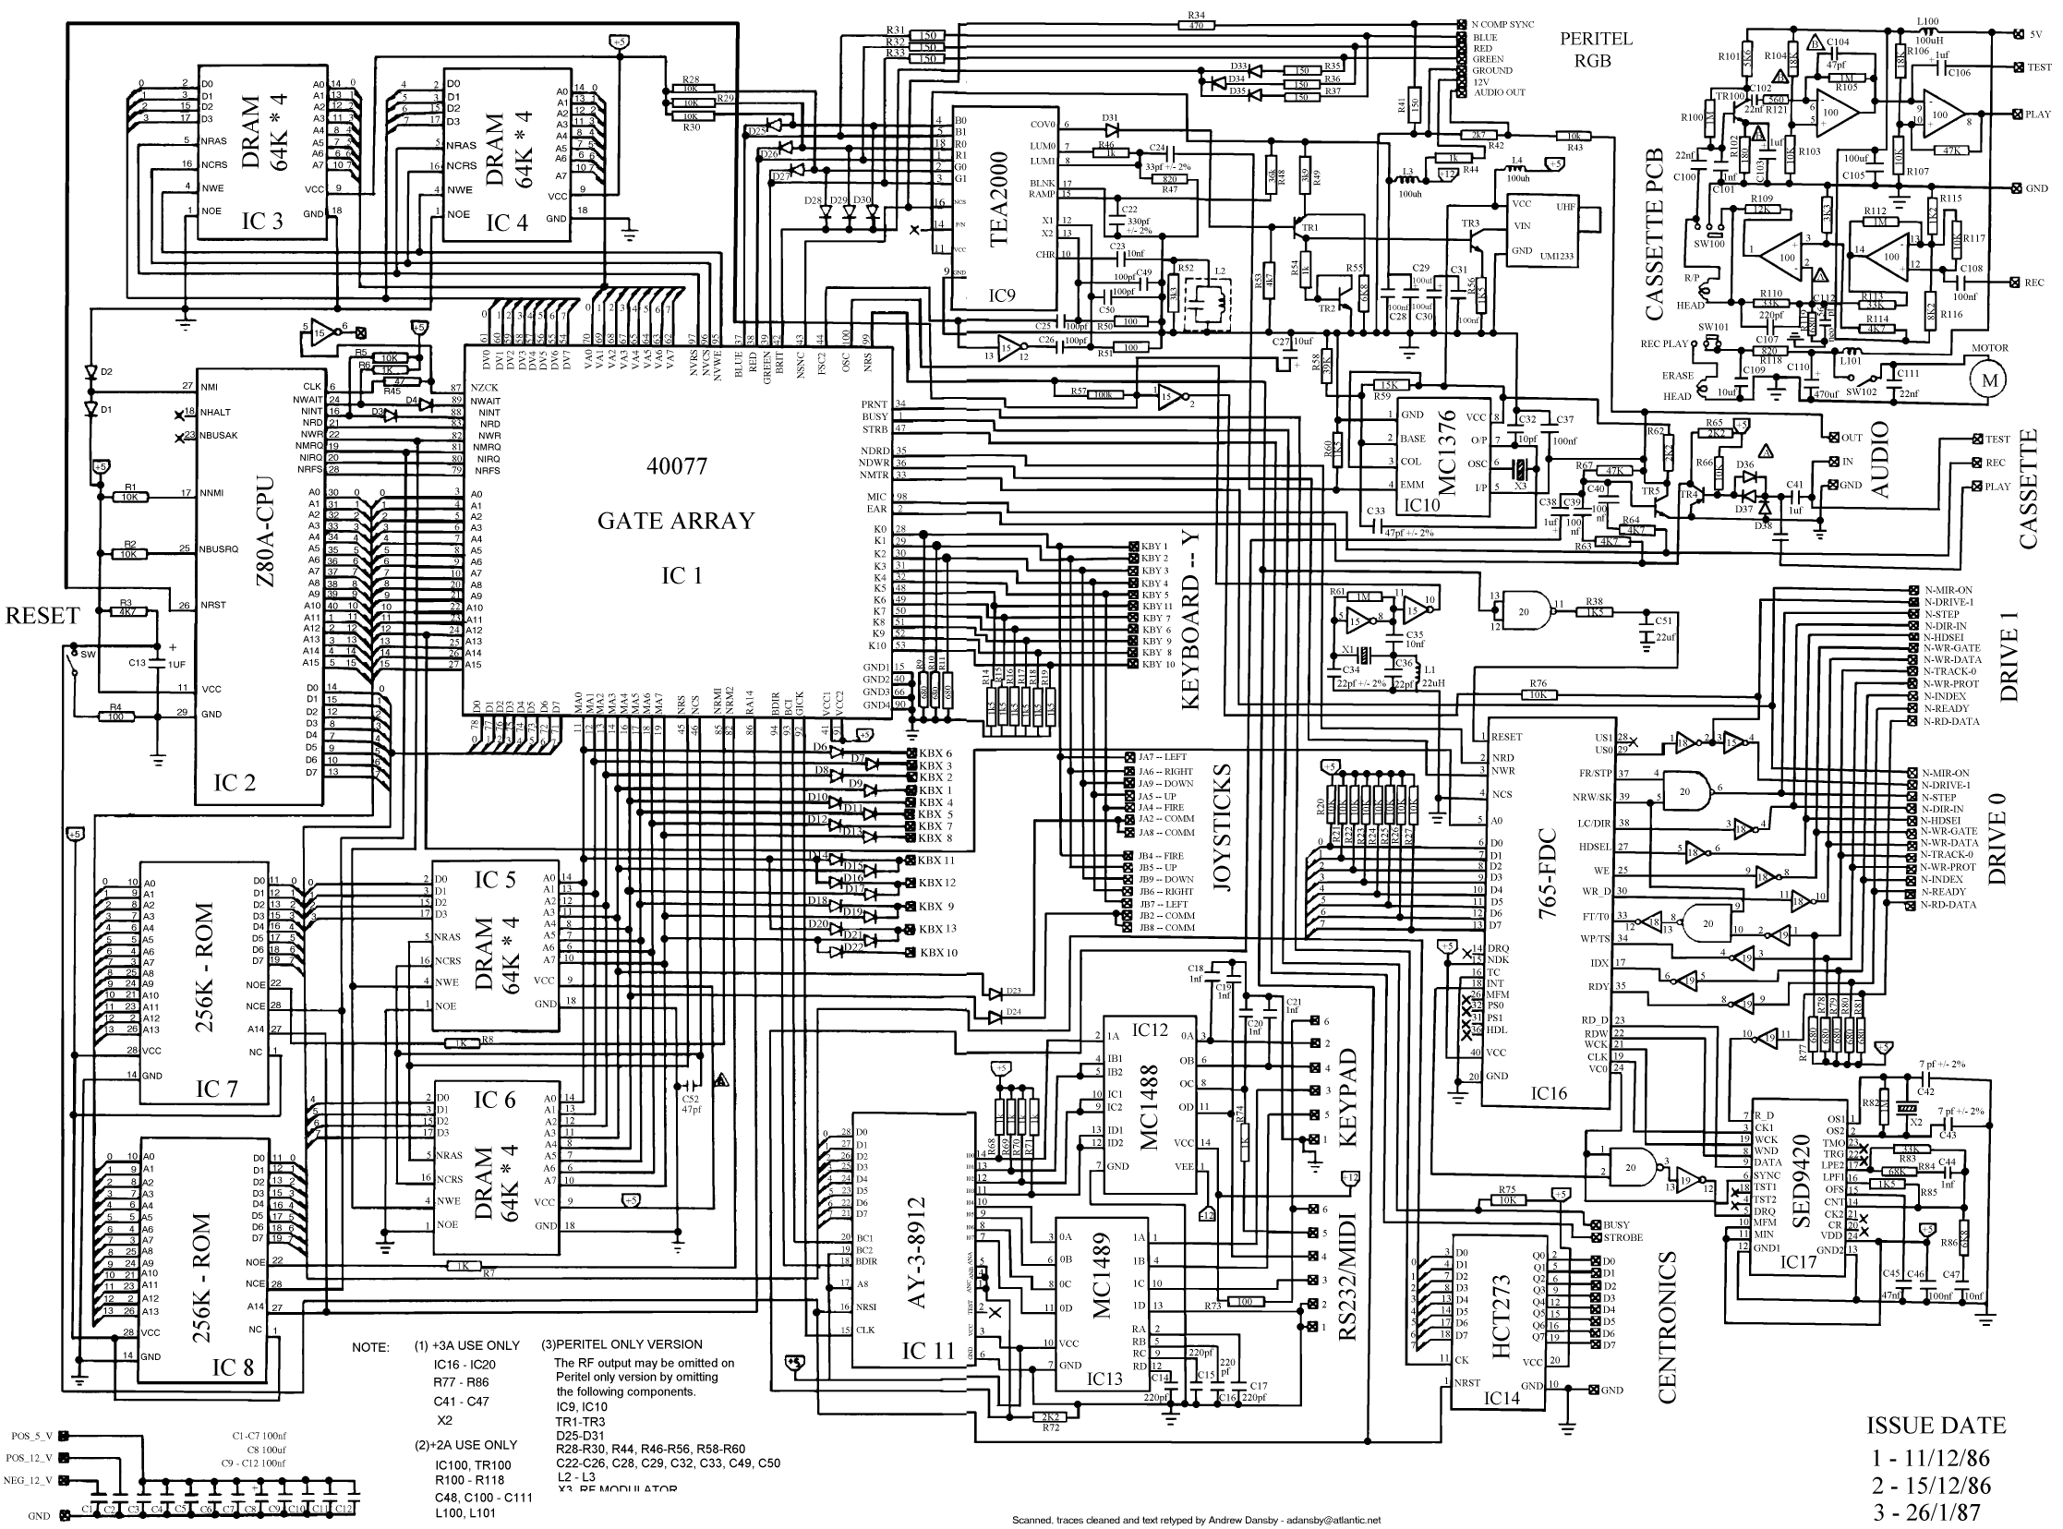

Slide 48
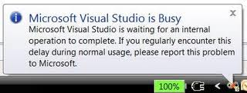

Slide 49
Problem in Mapping Fragments starting at lines 6, 69: Non-Primary-Key column(s) CalendarID are being mapped in both fragments to different conceptual side properties - data inconsistency is possible because the corresponding conceptual side properties can be independently modified.

Slide 50
Problem i Kartlegging Fragments starter på 6 linjer, 69: Ikke-Primær-Key kolonnen (e) CalendarID blir kartlagt i begge fragmenter til ulike konseptuelle side egenskaper - data inkonsekvens er mulig fordi de tilsvarende konseptuelle sidene egenskaper kan være uavhengig endres.

Slide 51
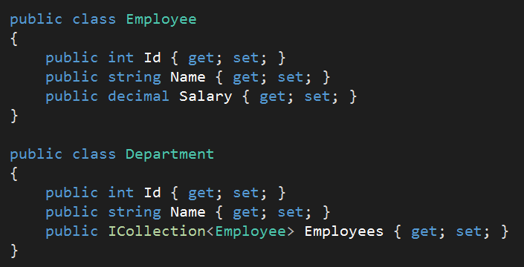
<?xml version="1.0" encoding="utf-8"?>
<edmx:Edmx Version="3.0" xmlns:edmx="http://schemas.microsoft.com/ado/2009/11/edmx">
<!-- EF Runtime content -->
<edmx:Runtime>
<!-- SSDL content -->
<edmx:StorageModels>
<Schema Namespace="Model1.Store" Alias="Self" Provider="System.Data.SqlClient" ProviderManifestToken="2008" xmlns:store="http://schemas.microsoft.com/ado/2007/12/edm/EntityStoreSchemaGenerator" xmlns="http://schemas.microsoft.com/ado/2009/11/edm/ssdl">
<EntityContainer Name="Model1StoreContainer">
<EntitySet Name="Employees" EntityType="Model1.Store.Employees" store:Type="Tables" Schema="dbo" />
<EntitySet Name="Departments" EntityType="Model1.Store.Departments" store:Type="Tables" Schema="dbo" />
<AssociationSet Name="EmployeeDepartment" Association="Model1.Store.EmployeeDepartment">
<End Role="Employee" EntitySet="Employees" />
<End Role="Department" EntitySet="Departments" />
</AssociationSet>
</EntityContainer>
<EntityType Name="Employees">
<Key>
<PropertyRef Name="Id" />
</Key>
<Property Name="Id" Type="int" StoreGeneratedPattern="Identity" Nullable="false" />
<Property Name="Name" Type="nvarchar(max)" Nullable="false" />
<Property Name="Salary" Type="nvarchar(max)" Nullable="false" />
<Property Name="HireDate" Type="nvarchar(max)" Nullable="false" />
<Property Name="EmployeeDepartment_Employee_Id" Type="int" Nullable="false" />
</EntityType>
<EntityType Name="Departments">
<Key>
<PropertyRef Name="Id" />
</Key>
<Property Name="Id" Type="int" StoreGeneratedPattern="Identity" Nullable="false" />
<Property Name="Name" Type="nvarchar(max)" Nullable="false" />
</EntityType>
<Association Name="EmployeeDepartment">
<End Role="Employee" Type="Model1.Store.Employees" Multiplicity="*" />
<End Role="Department" Type="Model1.Store.Departments" Multiplicity="1" />
<ReferentialConstraint>
<Principal Role="Department">
<PropertyRef Name="Id" />
</Principal>
<Dependent Role="Employee">
<PropertyRef Name="EmployeeDepartment_Employee_Id" />
</Dependent>
</ReferentialConstraint>
</Association>
</Schema></edmx:StorageModels>
<!-- CSDL content -->
<edmx:ConceptualModels>
<Schema xmlns="http://schemas.microsoft.com/ado/2009/11/edm" xmlns:cg="http://schemas.microsoft.com/ado/2006/04/codegeneration" xmlns:store="http://schemas.microsoft.com/ado/2007/12/edm/EntityStoreSchemaGenerator" Namespace="Model1" Alias="Self" xmlns:annotation="http://schemas.microsoft.com/ado/2009/02/edm/annotation" annotation:UseStrongSpatialTypes="false">
<EntityContainer Name="Model1Container" annotation:LazyLoadingEnabled="true">
<EntitySet Name="Employees" EntityType="Model1.Employee" />
<EntitySet Name="Departments" EntityType="Model1.Department" />
<AssociationSet Name="EmployeeDepartment" Association="Model1.EmployeeDepartment">
<End Role="Employee" EntitySet="Employees" />
<End Role="Department" EntitySet="Departments" />
</AssociationSet>
</EntityContainer>
<EntityType Name="Employee">
<Key>
<PropertyRef Name="Id" />
</Key>
<Property Type="Int32" Name="Id" Nullable="false" annotation:StoreGeneratedPattern="Identity" />
<Property Type="String" Name="Name" Nullable="false" />
<Property Type="String" Name="Salary" Nullable="false" />
<Property Type="String" Name="HireDate" Nullable="false" />
</EntityType>
<EntityType Name="Department">
<Key>
<PropertyRef Name="Id" />
</Key>
<Property Type="Int32" Name="Id" Nullable="false" annotation:StoreGeneratedPattern="Identity" />
<Property Type="String" Name="Name" Nullable="false" />
<NavigationProperty Name="Employees" Relationship="Model1.EmployeeDepartment" FromRole="Department" ToRole="Employee" />
</EntityType>
<Association Name="EmployeeDepartment">
<End Type="Model1.Employee" Role="Employee" Multiplicity="*" />
<End Type="Model1.Department" Role="Department" Multiplicity="1" />
</Association>
</Schema>
</edmx:ConceptualModels>
<!-- C-S mapping content -->
<edmx:Mappings>
<Mapping Space="C-S" xmlns="http://schemas.microsoft.com/ado/2009/11/mapping/cs">
<EntityContainerMapping StorageEntityContainer="Model1StoreContainer" CdmEntityContainer="Model1Container">
<EntitySetMapping Name="Employees">
<EntityTypeMapping TypeName="IsTypeOf(Model1.Employee)">
<MappingFragment StoreEntitySet="Employees">
<ScalarProperty Name="Id" ColumnName="Id" />
<ScalarProperty Name="Name" ColumnName="Name" />
<ScalarProperty Name="Salary" ColumnName="Salary" />
<ScalarProperty Name="HireDate" ColumnName="HireDate" />
</MappingFragment>
</EntityTypeMapping>
</EntitySetMapping>
<EntitySetMapping Name="Departments">
<EntityTypeMapping TypeName="IsTypeOf(Model1.Department)">
<MappingFragment StoreEntitySet="Departments">
<ScalarProperty Name="Id" ColumnName="Id" />
<ScalarProperty Name="Name" ColumnName="Name" />
</MappingFragment>
</EntityTypeMapping>
</EntitySetMapping>
<AssociationSetMapping Name="EmployeeDepartment" TypeName="Model1.EmployeeDepartment" StoreEntitySet="Employees">
<EndProperty Name="Department">
<ScalarProperty Name="Id" ColumnName="EmployeeDepartment_Employee_Id" />
</EndProperty>
<EndProperty Name="Employee">
<ScalarProperty Name="Id" ColumnName="Id" />
</EndProperty>
</AssociationSetMapping>
</EntityContainerMapping>
</Mapping></edmx:Mappings>
</edmx:Runtime>
<!-- EF Designer content (DO NOT EDIT MANUALLY BELOW HERE) -->
<edmx:Designer xmlns="http://schemas.microsoft.com/ado/2009/11/edmx">
<edmx:Connection>
<DesignerInfoPropertySet>
<DesignerProperty Name="MetadataArtifactProcessing" Value="EmbedInOutputAssembly" />
</DesignerInfoPropertySet>
</edmx:Connection>
<edmx:Options>
<DesignerInfoPropertySet>
<DesignerProperty Name="ValidateOnBuild" Value="true" />
<DesignerProperty Name="EnablePluralization" Value="True" />
</DesignerInfoPropertySet>
</edmx:Options>
<!-- Diagram content (shape and connector positions) -->
<edmx:Diagrams>
</edmx:Diagrams>
</edmx:Designer>
</edmx:Edmx>

Slide 52
#nav a:hover { background-color: #AD310B;
transition: background-color 1000ms linear; }
<Canvas.Triggers>
<EventTrigger RoutedEvent="Canvas.Loaded">
<BeginStoryboard>
<Storyboard x:Name="ColorStoryboard">
<ColorAnimation
BeginTime="00:00:00"
Storyboard.TargetName="Page"
Storyboard.TargetProperty=
"(Panel.Background).(SolidColorBrush.Color)
From="Red"
To="Green"
Duration="0:0:4" />
</Storyboard>
</BeginStoryboard>
</EventTrigger>
</Canvas.Triggers>

Slide 53
Lesson 5 Have Empathy For The Customer

Slide 54
EF 5

Slide 55
Getting Started
public class Movie
{
public int Id { get; set; }
public string Title { get; set; }
}
public class MovieDb: DbContext
{
public DbSet<Movie> Movies { get; set; }
}

Slide 56
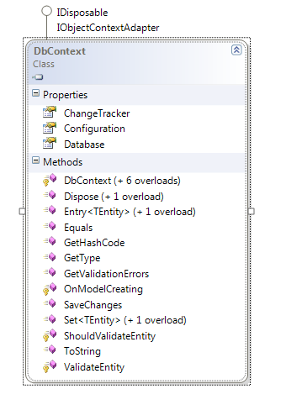
DbContext

Slide 57
Construction & Connecting
Convention
Config entry
Explicit
EDMX is optional
public class MovieDb: DbContext
{
public MovieDb() :base("movie_sql_db")
{
}
public DbSet<Movie> Movies { get; set; }
}

Slide 58
Initialization & Seeding
EF knows if the model changes …
Database.SetInitializer(
new DropCreateDatabaseIfModelChanges<MovieDb>());
public class MovieDbInitializtion
: DropCreateDatabaseAlways<MovieDb>
{
protected override void Seed(MovieDb context)
{
new Movie() {Title = "Pulp Fiction "};
new Movie() {Title = "The Matrix"};
base.Seed(context);
}
}

Slide 59
Mapping
Fluent API
Data Annotations
Key
Concurrency
Timestamp
DatabaseGenerated
protected override void OnModelCreating(DbModelBuilder modelBuilder)
{
modelBuilder.Entity<Movie>()
.HasKey(m => m.Pkey)
.ToTable("tbl_movies");
base.OnModelCreating(modelBuilder);
}

Slide 60
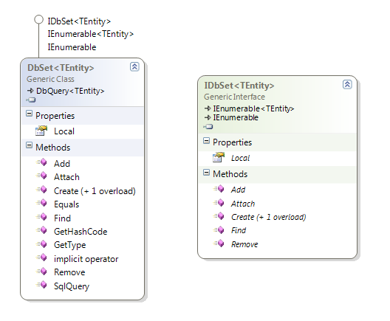
DbSets
Use DbSet<T>
Use IDbSet<T>
Can be read-only

Slide 61
Retrieving Entities
Use LINQ queries
Use Find (with a primary key)
Will use cached entities
var db = new MovieDb();
var movie = db.Movies.Single(m => m.Id == 1);
var db = new MovieDb();
var movie = db.Movies.Find(1);

Slide 62
Entity States
Added
Deleted
Detached
Modified
Unchanged
Movie newMovie = new Movie() {Title = "Star Wars"};
DbEntityEntry<Movie> entry = db.Entry(newMovie);
EntityState state = entry.State;

Slide 63
Proxies
EF will generate dynamic proxies by default
var movie = db.Movies.Single(m => m.Id == 3);
var type = ObjectContext.GetObjectType(movie.GetType());

Slide 64
Attaching
Attached entities in an Unchanged state
db.Entry(movie).State = EntityState.Modified;
db.SaveChanges();

Slide 65
Property Values
Several ways to access values in an entity
var entry = db.Entry(movie);
var isModified = entry.Property(m => m.Title).IsModified;
if(isModified)
{
var curentTitle = entry.Property(m => m.Title).CurrentValue;
var originalTitle = entry.Property(m => m.Title).OriginalValue;
}
var values = entry.GetDatabaseValues();
foreach (var name in values.PropertyNames
{
Console.WriteLine(values[name]);
}

Slide 66
Loading
Use Include to eager load
Always loads all related entities
Lazy loading
Achieved through proxies and virtual properties
var db = new MovieDb();
var query = db.Movies.Include(m => m.Reviews)
.Where(m => m.Id == 3);

Slide 67
Explicit and Filtered Loads
if(!db.Entry(movie).Collection(m => m.Reviews).IsLoaded)
{
db.Entry(movie).Collection(m => m.Reviews).Load();
}
db.Entry(movie).Collection(m => m.Reviews)
.Query()
.Where(r => r.Username == "Scott")
.Load();

Slide 68
Local Data
Local property contains entities tracked by DbContext
It is an ObservableCollection
var db = new MovieDb();
db.Movies.Local.CollectionChanged += (s, e) =>
{
foreach(var newItem in e.NewItems)
{
Console.WriteLine(db.Entry(newItem).State);
}
};

Slide 69
Optimistic Concurrency
try
{
db.SaveChanges();
}
catch(DbUpdateConcurrencyException ex)
{
// ...
}

Slide 70
Working with SQL
var movies = db.Movies
.SqlQuery("SELECT * FROM movies WHERE Title LIKE {0}",
"Star%")
.ToList();
var movies =
db.Movies
.SqlQuery("SELECT * FROM movies WHERE Title LIKE @title",
new SqlParameter("@title", "Star%"))
.ToList();
var count = db.Database.SqlQuery<int>(
"SELECT COUNT(*) FROM movies");
int rows = db.Database.ExecuteSqlCommand("DELETE FROM movies");

Slide 71
Summary
Don’t let astronauts solve the customer’s problem
Solve one customer problem well
Don’t ask the customer for a long term loan
Understand the customer’s problem
Have empathy for the customer
Questions?
scott@OdeToCode.com

